Slide 1




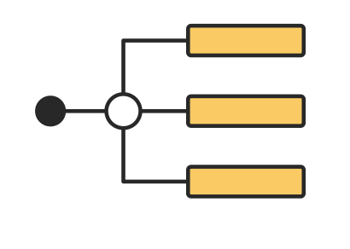
SAT Decision Scraper & Search Application with RAG
Project Client: Josh Tedjasaputra (Customer Experience Insight Pty Ltd)
Notes:
DONE

Slide 2

CONTENTS
1
Introduction
2
Data & Web scraper
3
Front-end
4
Graph search
5
RAG
6
Q & A
Notes:
DONE

Slide 3

01
Introduction
Notes:
DONE

Slide 4


INTRODUCTION
SAT (State Administrative Tribunal） has published many tribunal decisions and cases over the years.
CHALLENGES：
Cases and decisions are not easy to search.
Difficult to customize search requirements.
Relevant knowledge base is inadequate.
TARGET USERS：
General : General purpose for everyday seeking information for public user.
Professional : Lawyers, Judgers
Notes:
FIXME

Slide 5
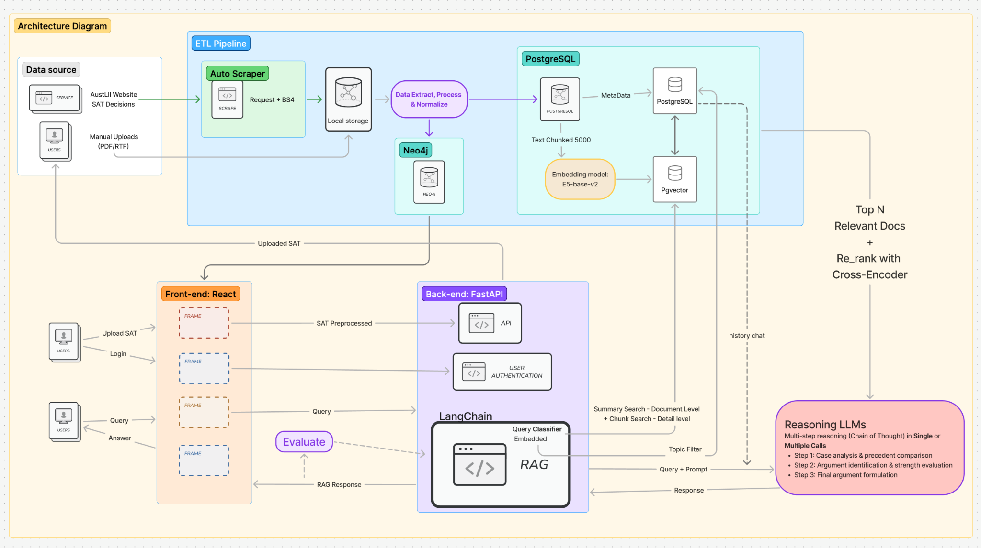
High-level architecture
Project Features
Data source
Database
RAG
Front-end
Notes:
FIXME

Slide 6
02
DATA AND WEB SCRAPER

Slide 7
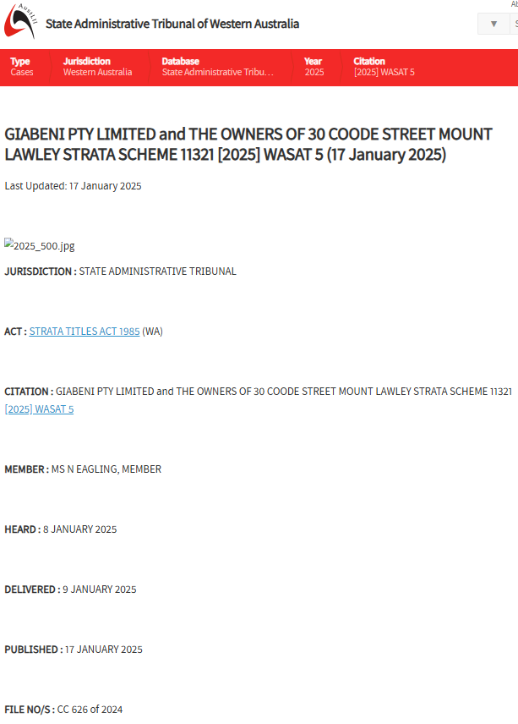
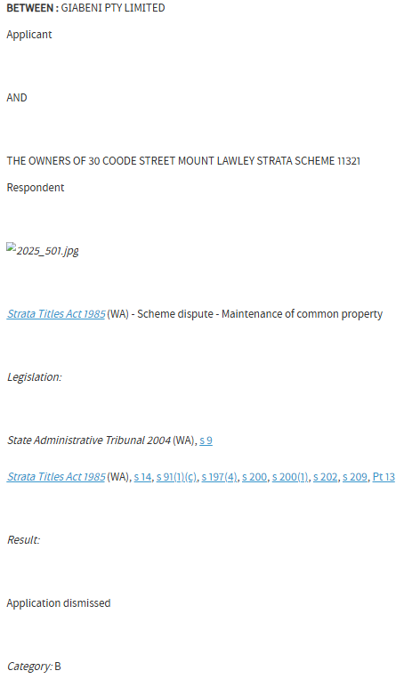
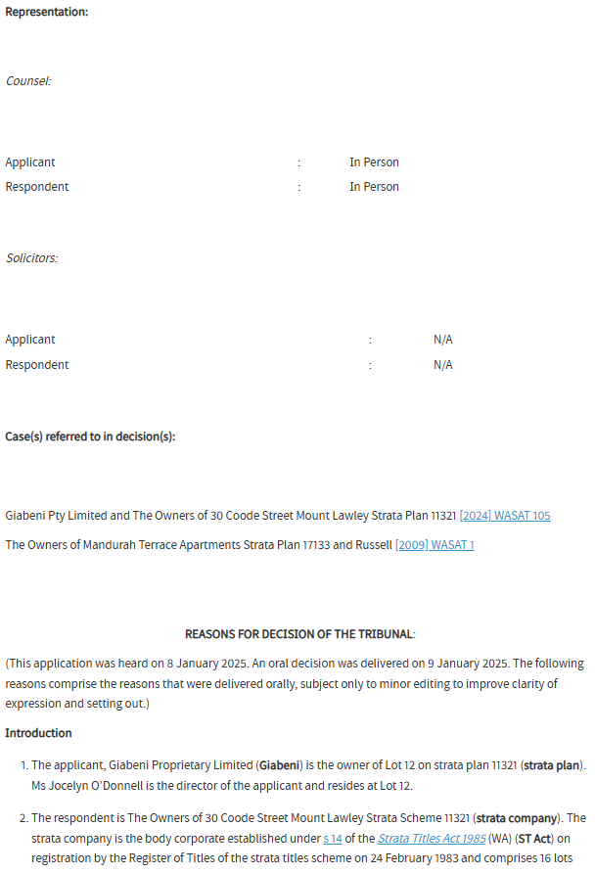
SAT Decision data

Slide 8
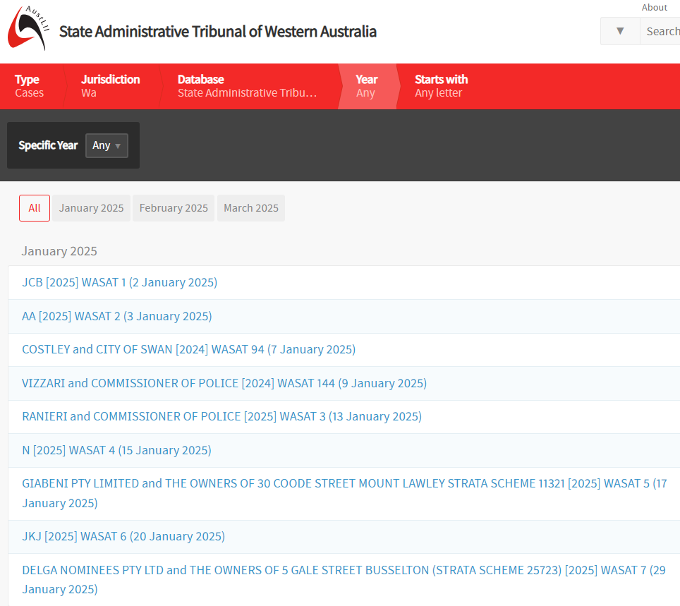





Data extraction process
Data is preprocessed and text data is used to map case acts to topics, create summaries and embeddings
Data is scraped from AustLII database
Preprocessed data is
Exported into JSON format.
Pipeline is created to insert preprocessed data into PostgreSQL
Scrape AustLII data
Preprocess data
Export data as JSON
Insert data into PostgreSQL

Slide 9
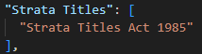
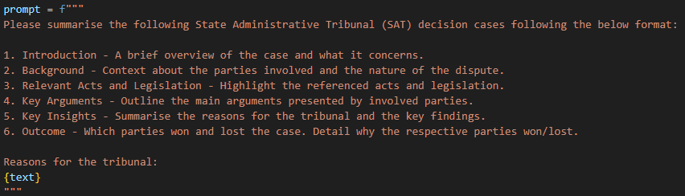
Data preprocessing
Each of the extracted fields is preprocessed to remove special characters such as ‘\n’ and ‘\t’
SAT decision are categorised on its ‘case_topic’ for fast retrieval in the database. A pipeline is created to automatically map each SAT decision to a ‘case_topic’ based on its extracted ‘case_act’
Summaries are generated using OpenAI’s gpt-4o-mini model. A prompt is fed into the model to extract key points from the ‘reasons’ field.
Text embeddings are generated from the generated summary using E5-base-v2 Huggingface model.
case_act
case_topic

Slide 10
Cost comparison

Slide 11
Rank (Borda) * | Model * | Memory Usage (MB) * | Number of Parameters * | Embedding Dimensions * | Max Tokens * | Mean (Task) * | Mean (TaskType) * | Reranking * | Retrieval * | STS *
10 | Cohere-embed-multilingual-v3.0 | Unknown | Unknown | 1024 | Unknown | 61.1 | 53.31 | 64.07 | 59.16 | 74.8
40 | Cohere-embed-english-v3.0 | Unknown | Unknown | 1024 | Unknown | 48.19 | 41.85 | 50.68 | 45.41 | 64.72
56 | e5-base-v2 | 418 | 109M | 768 | 512 | 46.03 | 39.41 | 47.5 | 40.49 | 60.73
113 | all-MiniLM-L6-v2 | 87 | 22M | 384 | 256 | 41.43 | 35.18 | 40.28 | 32.51 | 56.08
158 | text-embedding-ada-002 | Unknown | Unknown | 1536 | 8191

Slide 12
Model * | License * | Parameters (B) * | Context * | Input $/M * | Output $/M * | MMLU * | DROP *
GPT-4 | Proprietary | - | 32,768 | $30.00 | $60.00 | 86.40% | 80.90%
o1 | Proprietary | - | 200,000 | $15.00 | $60.00 | 91.80% | -
o1-preview | Proprietary | - | 128,000 | $15.00 | $60.00 | 90.80% | -
GPT-4 Turbo | Proprietary | - | 128,000 | $10.00 | $30.00 | 86.50% | 86.00%
o1-mini | Proprietary | - | 128,000 | $3.00 | $12.00 | 85.20% | -
GPT-4o | Proprietary | - | 128,000 | $2.50 | $10.00 | 88.00% | -
GPT-4o mini | Proprietary | - | 128,000 | $0.15 | $0.60 | 82.00% | 79.70%
Llama 3.1 405B Instruct | Open | 405 | 128,000 | $0.90 | $0.90 | 87.30% | 84.80%
DeepSeek-R1 | Open | 671 | 131,072 | $0.55 | $2.19 | 90.80% | 92.20%
GPT-3.5 Turbo | Proprietary | - | 16,385 | $0.50 | $1.50 | 69.80% | 70.20%
Llama 3.2 90B Instruct | Open | 90 | 128,000 | $0.35 | $0.40 | 86.00% | -
Qwen2.5 72B Instruct | Open | 72.7 | 131,072 | $0.35 | $0.40 | - | -

Slide 13


Data storage
The resulting data from the previous stage are stored into the local PostgreSQL database. Generated vector embeddings are also stored into the database using pgvector which is an extension of PostgreSQL.
A database index is created on case_topic of the satdata table. This significantly speeds up searching and filtering on case_topic.

Slide 14
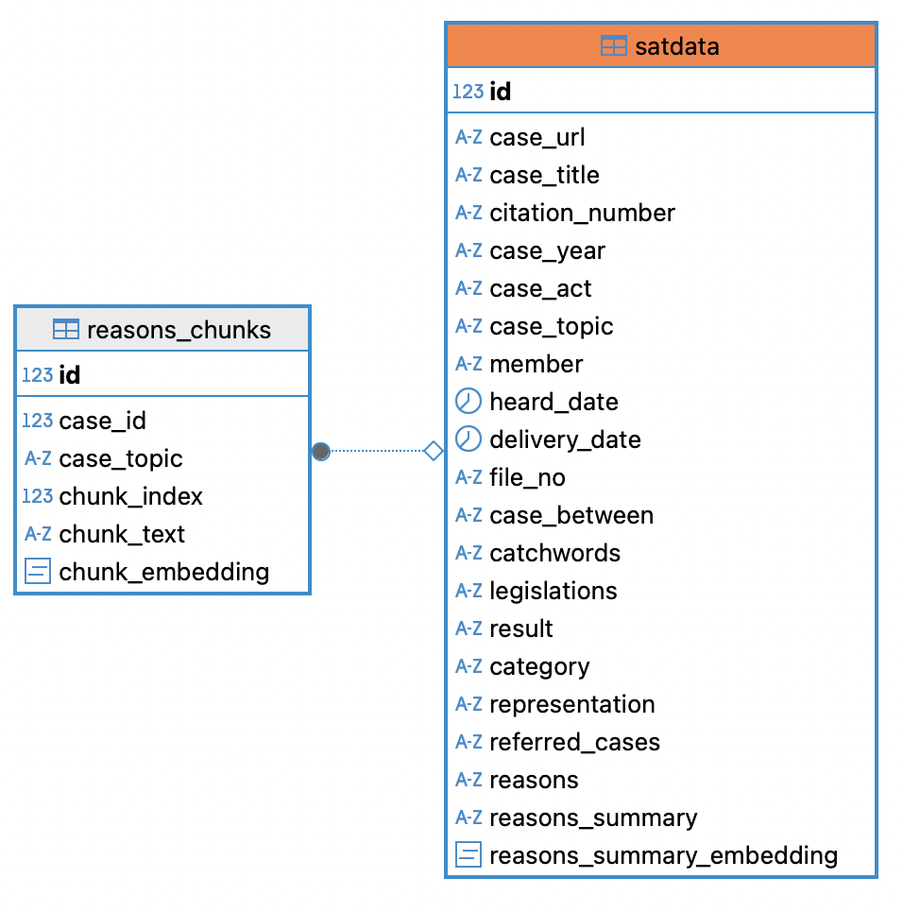
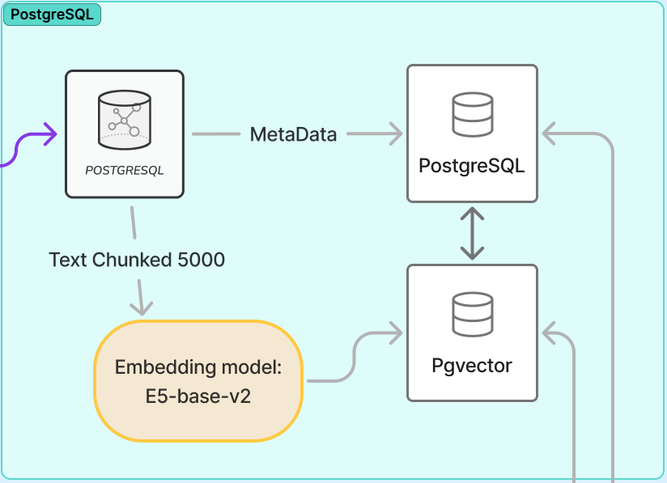
DB design
Notes:
FIXME

Slide 15
03
FRONT-END

Slide 16

FRONT-END
The most popular front-end platform in Australia:
Notes:
FIXME

Slide 17

04
GRAPH SEARCH

Slide 18

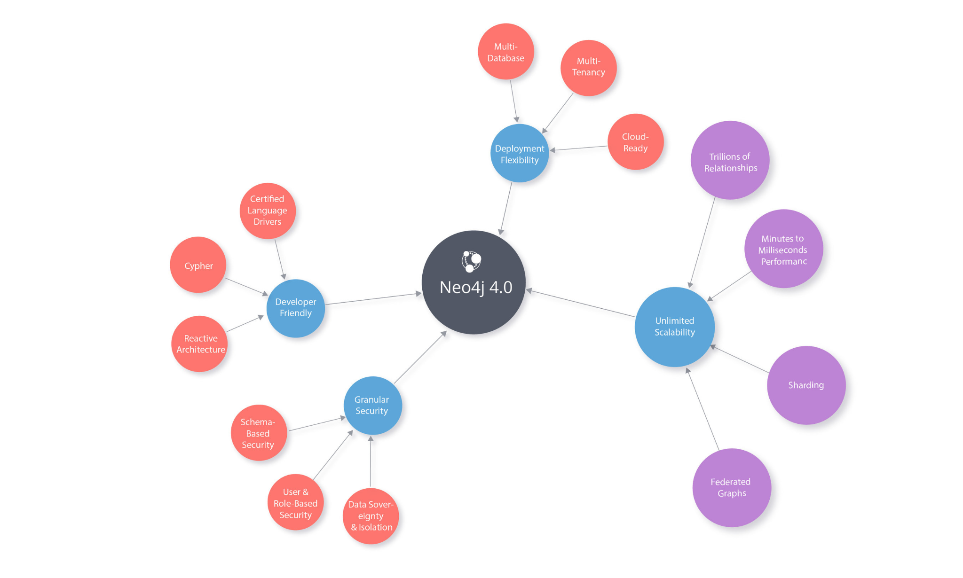
What is neo4j
Nodes
Relationships

Slide 19
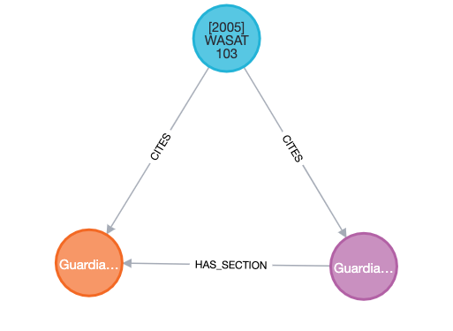
Neo4j design
Node Types:
Case: Represents legal cases.
Law: Represents legal statutes/laws.
Section: Represents specific provisions or sections within a law.
Relationship Types:
REFERENCES: Indicates that a case references other cases.
CITES: Indicates that a case cites a specific law.
HAS_SECTION: Indicates that a law has specific sections (such as s 77(2)).

Slide 20
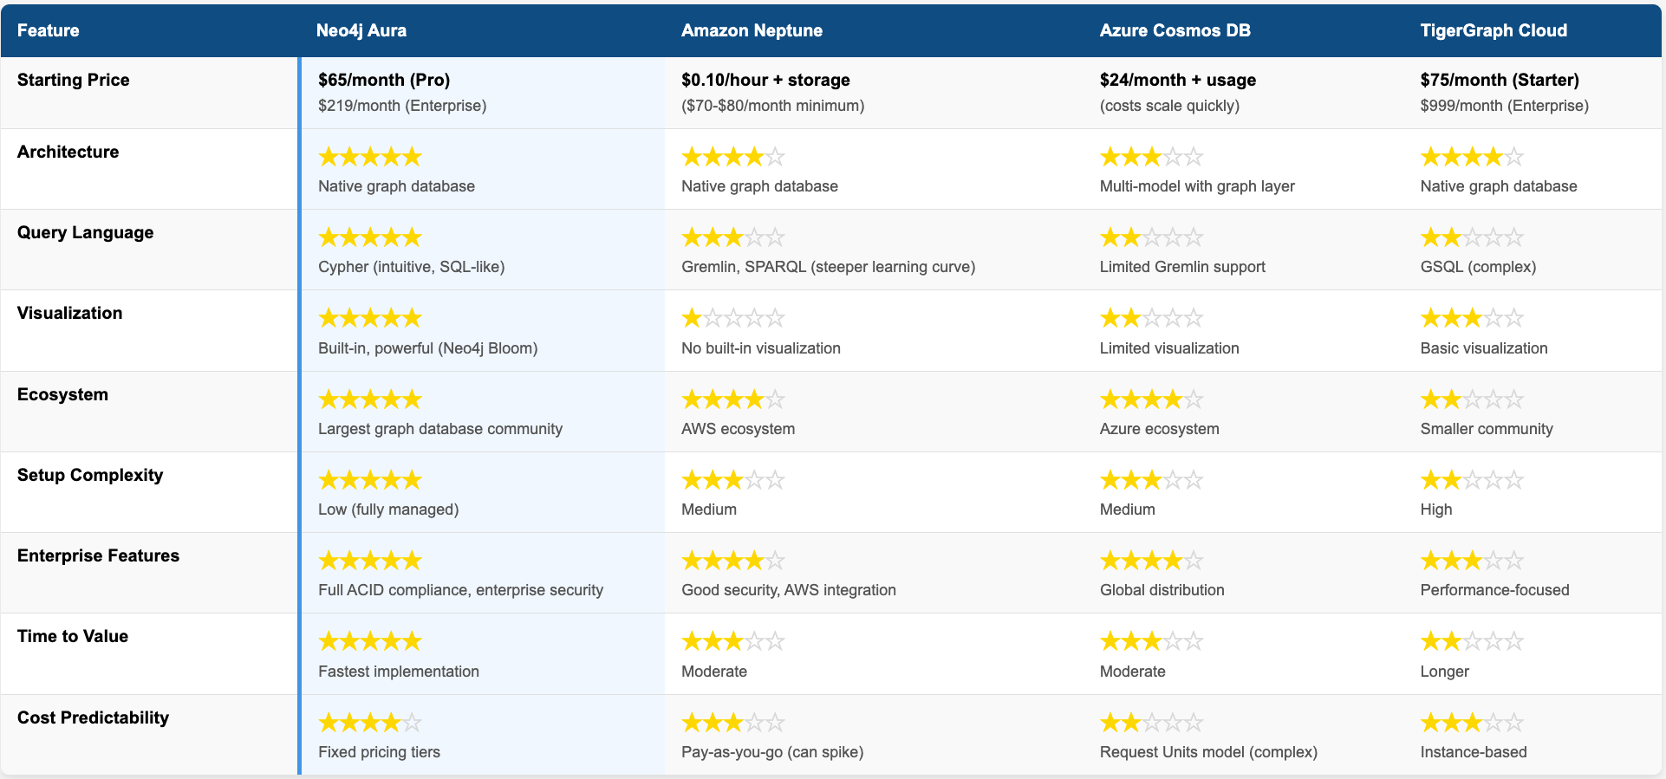
Why neo4j

Slide 21


05
R A G

Slide 22
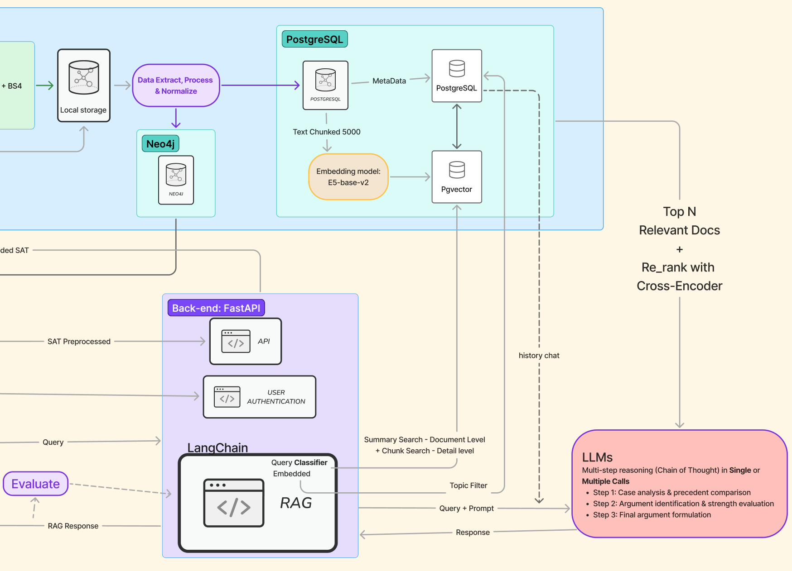
RAG - Architecture
Query Classifier + Embedding
Retrieve using Summary + Chunk Search
Rerank with cross encoder
Chain of Thought
LLMs Single Call vs. Multiple Call
Prompt Tuning
Evaluation

Slide 23
RAG demonstration

Slide 24
RAG Evaluation
Prompt Tuning: Aligning with Legal Reasoning Structures (IRAC/MIRAT)
Legal prompts are optimized using IRAC or MIRAT methodology
Issue - Identify (and articulate) the legal issue
Rule - State the law on the legal issue
Apply - The law to the facts of the problem scenario
Conclude - Give a conclusion where possible
10 prompt tuning strategies based on UNSW Law School guidance for legal writing
Clear input improves LLM output quality and relevance
Better Prompts = Better Answers
Notes:
Before we evaluate how well RAG works, we first need to make sure the prompts we give the model are high quality.
So we followed legal thinking frameworks like IRAC and MIRAT, they’re how lawyers usually break down legal problems, so its basically four parts, issue, rule, apply, and conclude.
We used this logic in our prompt tuning, so the model follows a more professional and clear reasoning process.
We also followed 10 key writing tips from UNSW Law School, to help the model focus on real legal rules, not just opinions.
This makes the outputs more structured — and easier to evaluate later on.

Slide 25
RAG Evaluation
Evaluation Varies by Legal Field
Evaluation must match the legal field
Contract law: 3 key analysis steps
Identification of the relevant terms of the contract
Identification of whether there is a breach of said terms, and;
Identification of whether the breach gives rise to the right to terminate the contract
Common legal questions (UNSW Law School guidance):
Is the contract valid?
Were terms breached?
… …
Different Fields = Different Criteria
Notes:
When evaluating RAG outputs, we can not use one same criteria for every legal field.
For example, in contract law, analysis usually follows three steps: find the contract terms, check for breach, and see if the breach allows contract termination.
We also look at key questions — like whether the contract is valid, if the parties performed their duties.
So the evaluation really depends on the legal context.

Slide 26
RAG Evaluation
Performance Marking Criteria
Format (20%): Does it follow IRAC clearly?
Accuracy (40%):
Legal Argument (10%)
Supporting Case Law (10%)
Cited Statute / Rule (10%)
Application (10%)
Reasoning (40%):
Contract terms correctly identified (10%)
Breach correctly assessed (15%)
Termination rights well reasoned (15%)
Notes:
In this slide, we test how the RAG system builds a legal argument using a real contract law case.
We input the case into our system and the model used DeepSeek and Claude to generate answers.
To evaluate this, we set clear marking criteria: output structure, legal accuracy, application, and reasoning. Each part has its own weight.
Then we asked law students to help review the outputs. We also used the GPT-4o reasoning model to help check the output quality.
One key takeaway was about case matching – to judge relevance, we should focus on the actual legal issues, not just surface topics. Even if two cases look pretty similar, what matters is whether the dispute point is the same.
This example shows how our system is able to generate legal arguments, and how we evaluate them using legal standards tailored to each field.

Slide 27
RAG Evaluation
Claude 3.7 – 3 Calls
Insights mostly correct
Strong argument logic
Good supporting cases, some are industry classics
Practical final advice
Related case matching needs improvement, limited by current dataset
DeepSeek R1 – Single Call
Some correct insights
Partially logical arguments
Supporting cases limited, few classics
Final advice vague
Case matching generally weak
Notes:
In this slide, we compare Claude 3.7 and DeepSeek R1 in terms of performance.
Claude performed better overall — its legal reasoning was more consistent, the supporting cases were more relevant, and the final advice was actually useful in practice.
DeepSeek’s single-call version gave some correct insights, but its reasoning was less structured, and the advice it provided was more vague.
We chose to only evaluate the single-call version of DeepSeek, because we believe single-shot prompting works better with models that already have strong internal reasoning. For models that are less robust, multi-step prompting can improve results — but DeepSeek’s 3-call setup takes several minutes to complete, which isn’t ideal for real-world use.

Slide 28
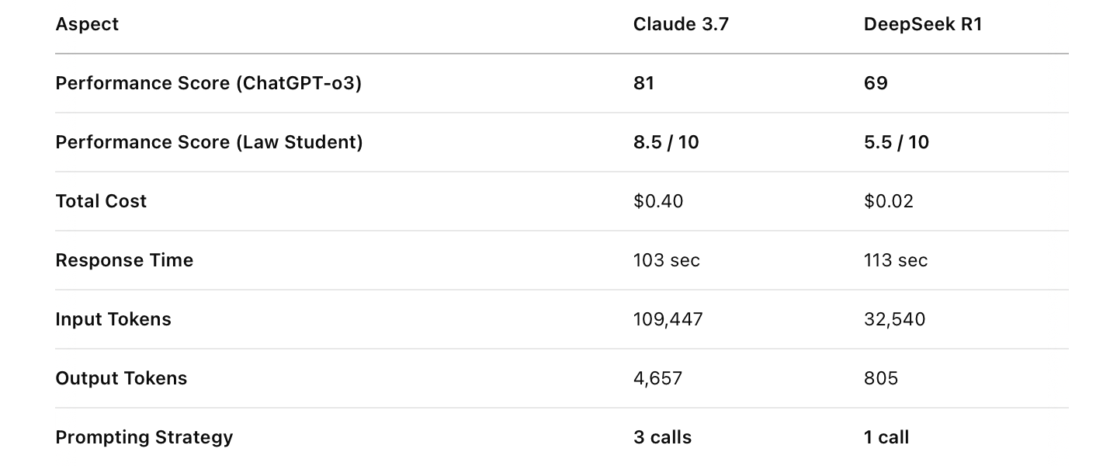
Cost Evaluation
🌟
Claude 3.7
DeepSeek R1
Notes:
In terms of cost and efficiency, Claude is more expensive — around $0.40 per run — and uses more tokens, especially in multi-step setups.
DeepSeek is much cheaper — only about $0.02 — and its response time is slightly faster in single-call settings.
So while Claude costs more, it delivers significantly higher-quality outputs. That tradeoff may be worth it in situations where legal accuracy and professional standards really matter.

Slide 29
06
Q & A

Slide 30
Thank You!

